Slide 1
Agile and Kanban
Jen Brownson
Enterprise Agile Architect

Slide 2
Agenda
Agile Overview
Roles and Teams
User Stories
Sprints
Kanban

Slide 3
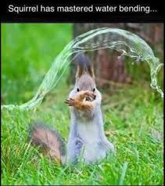
Jennifer Brownson
Certified SAFe Professional Consultant
Cert. Scrum Practitioner
CBAP, Agile Thought Leader
Have been a Business Analyst, EBA, ScrumMaster, InfoSec, PM, QA Manager, Tech Writer, Developer
Agile pulls it all together!

Slide 4

Crystal
Lean
Scrum
Kanban
XP
Scaled Agile
FDD
Notes:
Lots of different kinds of agile.

Slide 5
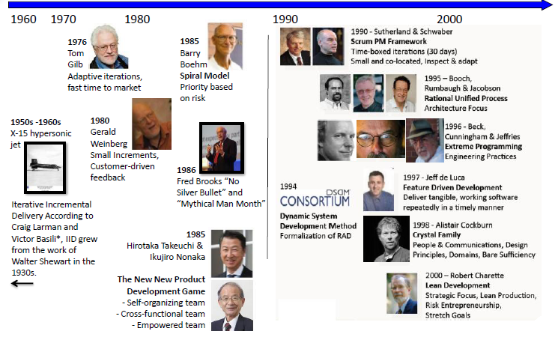
1950s - Current

Slide 6
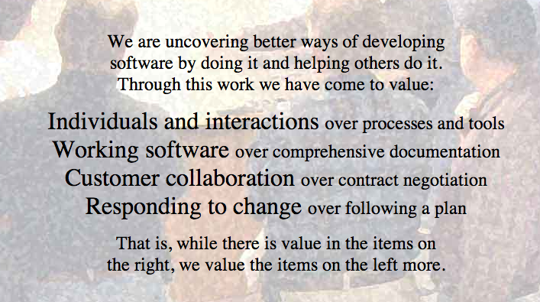

Slide 7
Agile Principles
Satisfy the customer through early and continuous delivery
Welcome changing requirements (with limits)
Deliver WORKING software frequently
Business people and the team work together daily
Build projects around motivated individuals
Convey information in face to face conversation

Slide 8
Agile Principles
Working software is the primary measure of progress
Maintain a constant pace indefinitely; no death marches!
Continuously focus on technical excellence in design and development
Simplify; maximize the amount of work NOT done
Teams organize themselves
Teams constantly reflect and adjust their behavior

Slide 9
Agile Terms
Backlog Item: Work Items, including, user stories and defects
Ranked Backlog: A list of Work Items prioritized by Value to the Business Stakeholders, Technical Risk, and Dependencies.
Minimal Viable Product (MVP): The “Must Haves” in order for a product to be released into Production.

Slide 10
Agile Terms
Functional User Story: A simple expression of a business stakeholder need.
Non-Functional User Story: A simple expression of a system need.
Task: A single unit of work that helps a backlog item reach delivery/acceptance.
Notes:
User story is the “what”; task is the “how”
3 factors of estimating: complexity, effort, doubt

Slide 11
Agile Terms
Time Box: A set period of time, such as three weeks. Time box sizes should not change.
Sprint: A regular, repeatable work cycle that is always the same Time Box. We currently run 3 week sprints.
Release: The date we will migrate to Production
Notes:
User story is the “what”; task is the “how”
3 factors of estimating: complexity, effort, doubt

Slide 12
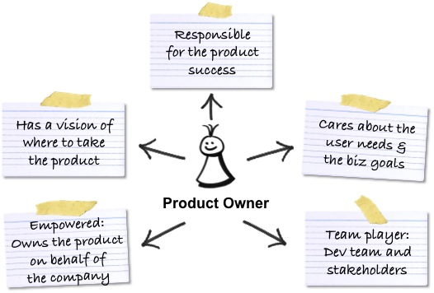
Product Owners

Slide 13
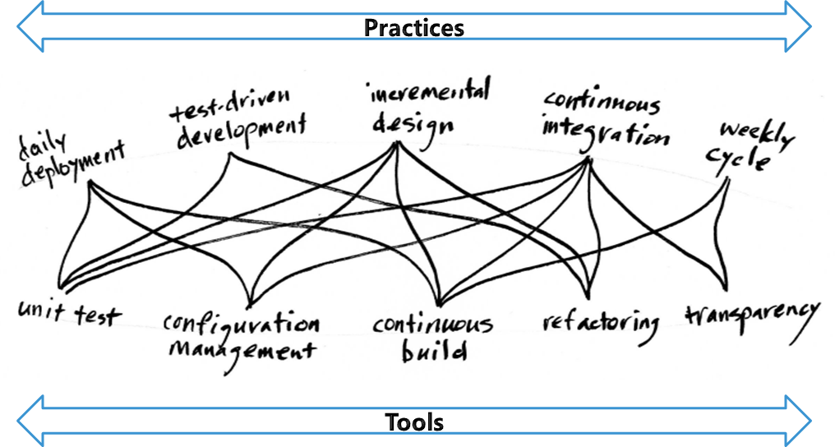
Development Team

Slide 14
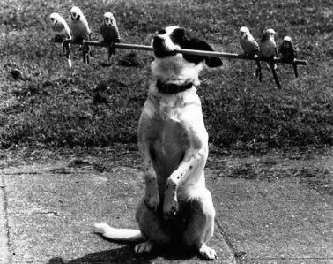
ScrumMasters

Slide 15
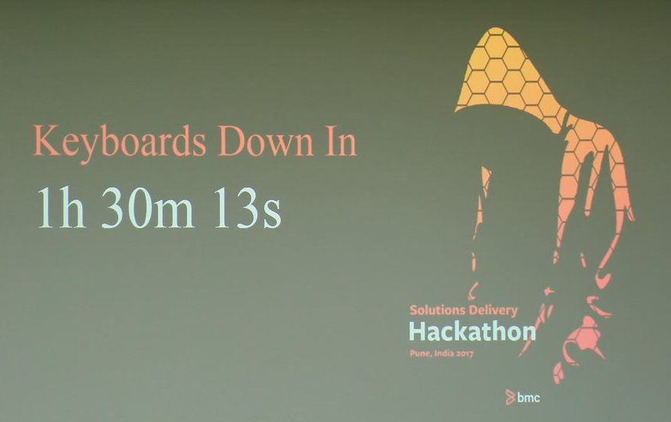

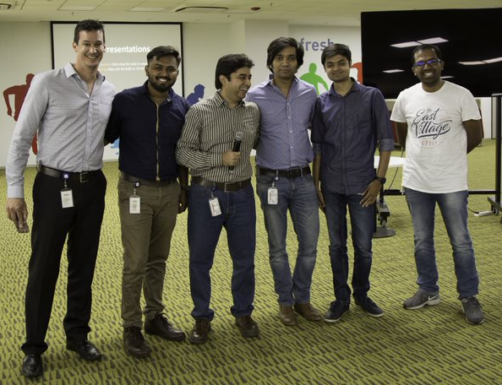

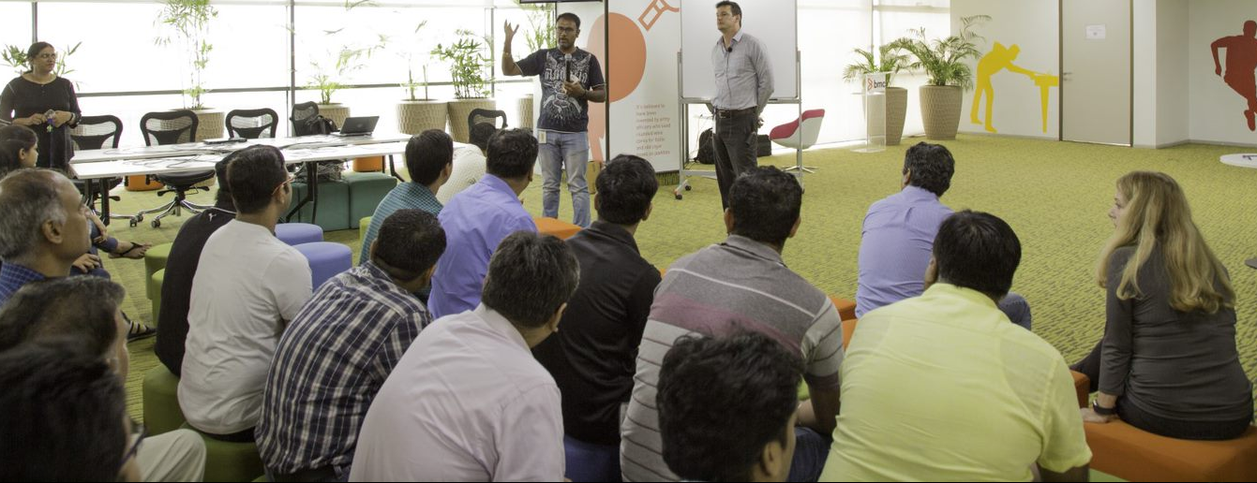
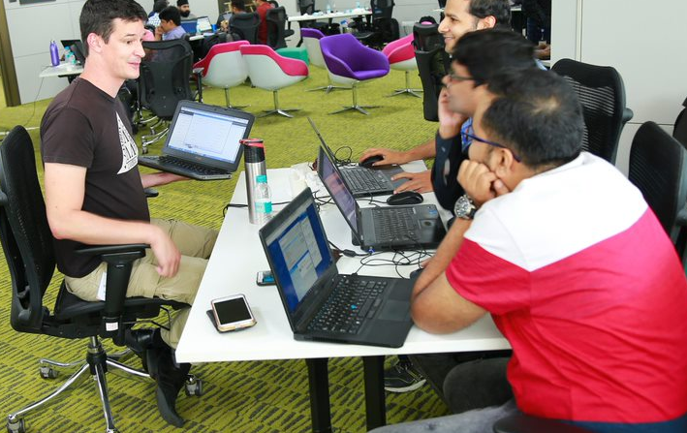
Teams

Slide 16
High-Performing Teams
Self-Organized
Backlog is ready at the sprint start
Short sprints
Visible Progress/Demos
Finishing, not just starting
Works in priority order
Avoids distractions
Continually improves their process

Slide 17
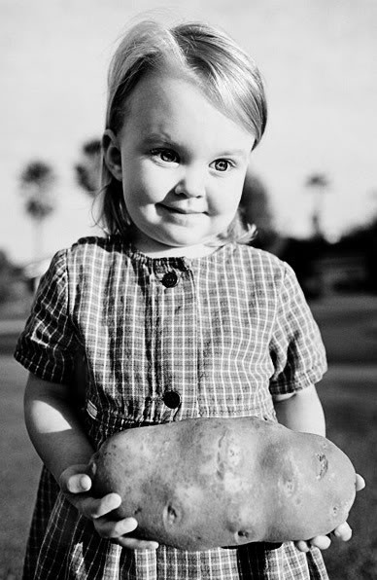
User Stories
User Stories: the basic unit of Agile work
Directly tied to increasing business or technical value
Focus on the stakeholder needs
Easy to prioritize
Small pieces of work
Allows for frequent feedback

Slide 18
Different Types of Stories
Functional: Business user stories. Express a business user’s requirements, written in business language
Non-Functional: Technical requirements for quality/maintainability of the system
Spikes: Research and/or prototyping activities
Notes:
Other types of requirements include use cases, ??? (what else)—what did Linda want us to say here?
Backlog items are NOT tasks

Slide 19
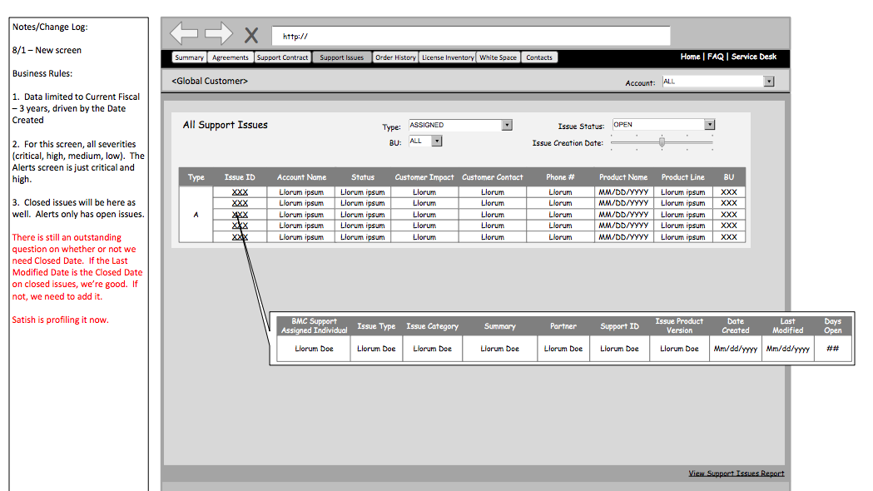
Wireframes!
Notes:
What is acceptance criteria?
19

Slide 20
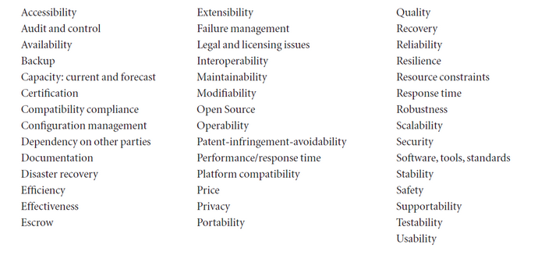
Types of Non-Functional Requirements

Slide 21
Example Non-Functional Stories
System must handle 3,000 users with 3-5 second response times
System must leverage OKTA for security
System responds to search requests within 10 seconds
System must support Chrome, Firefox, Safari, and Explorer (with versions)
System must have a mobile interface
All integrations requirements are non-functional
All data warehousing requirements are non-functional

Slide 22
Spikes
A story aimed at answering a question or gathering information, rather than at producing shippable product
Architectural
Prototypes
Research into new technologies
Must be completed prior to development
40 hours or less
Notes:
Talk about spike temptation. Use ServiceCloud for this.

Slide 23
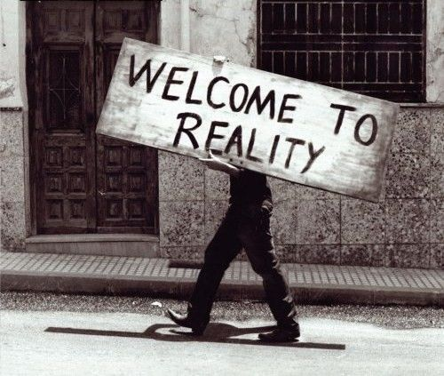
What’s a Sprint?
Time-boxed
Duration never changes
Scope is LOCKED
Team schedules and accepts work itself
Demo at the end of each sprint
ScrumMaster is a literal term in sprints!

Slide 24
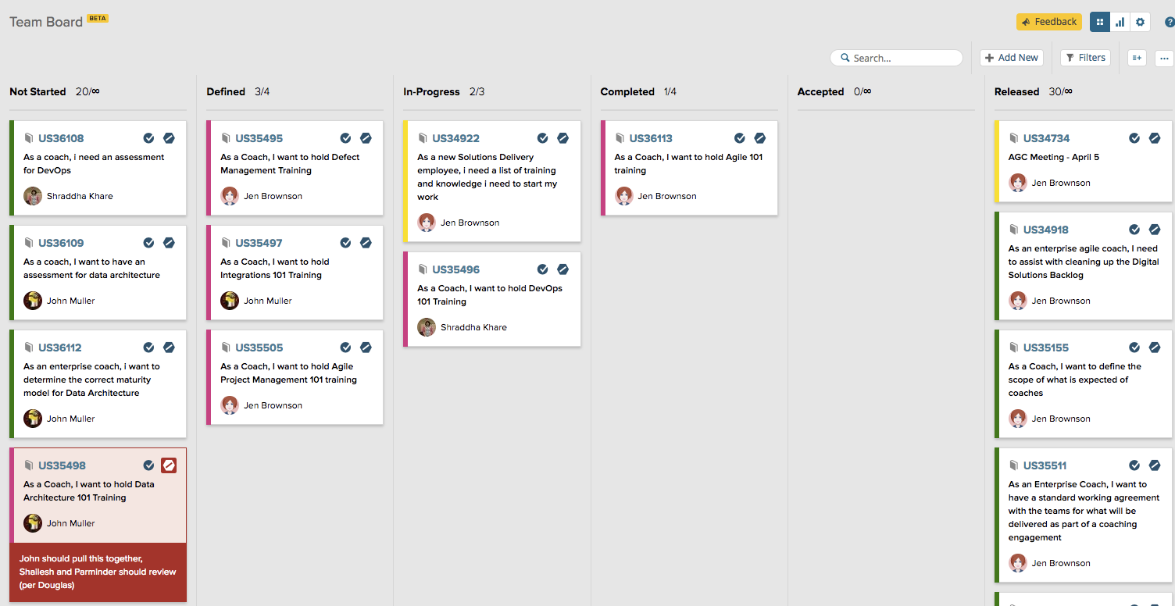
Kanban

Slide 25
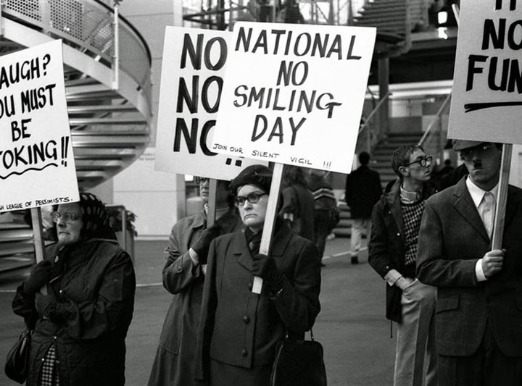
Every Day….
Hold daily scrum (15 minutes)
Use the Kanban Board
Block things you can’t work on
Work Defects!

Slide 26
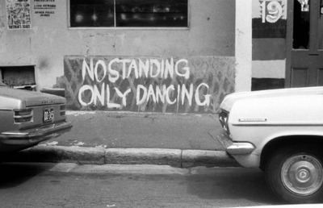
Daily Stand-Ups
15 minutes or less
Discuss issues and needs, not status
Everyone talks.
No one overtalks.
Not a defect management meeting

Slide 27
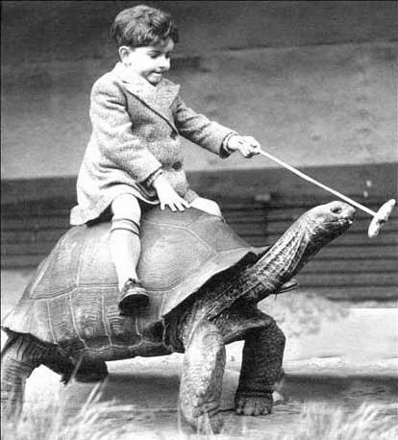
Sprint Retrospectives
Not optional
Facilitated by ScrumMaster
What worked?
What broke?
What should we change?
Add User Stories to backlog
Defect Resolution/Root Cause Analysis
Team Dynamics
Process Improvements
Automation Opportunities

Slide 28
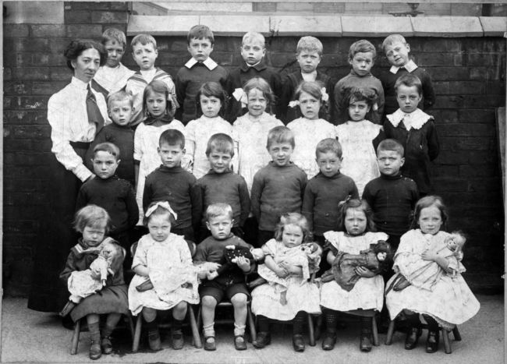
Questions?

